Slide 1
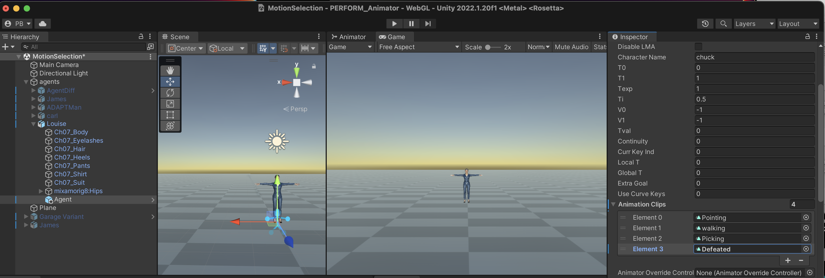
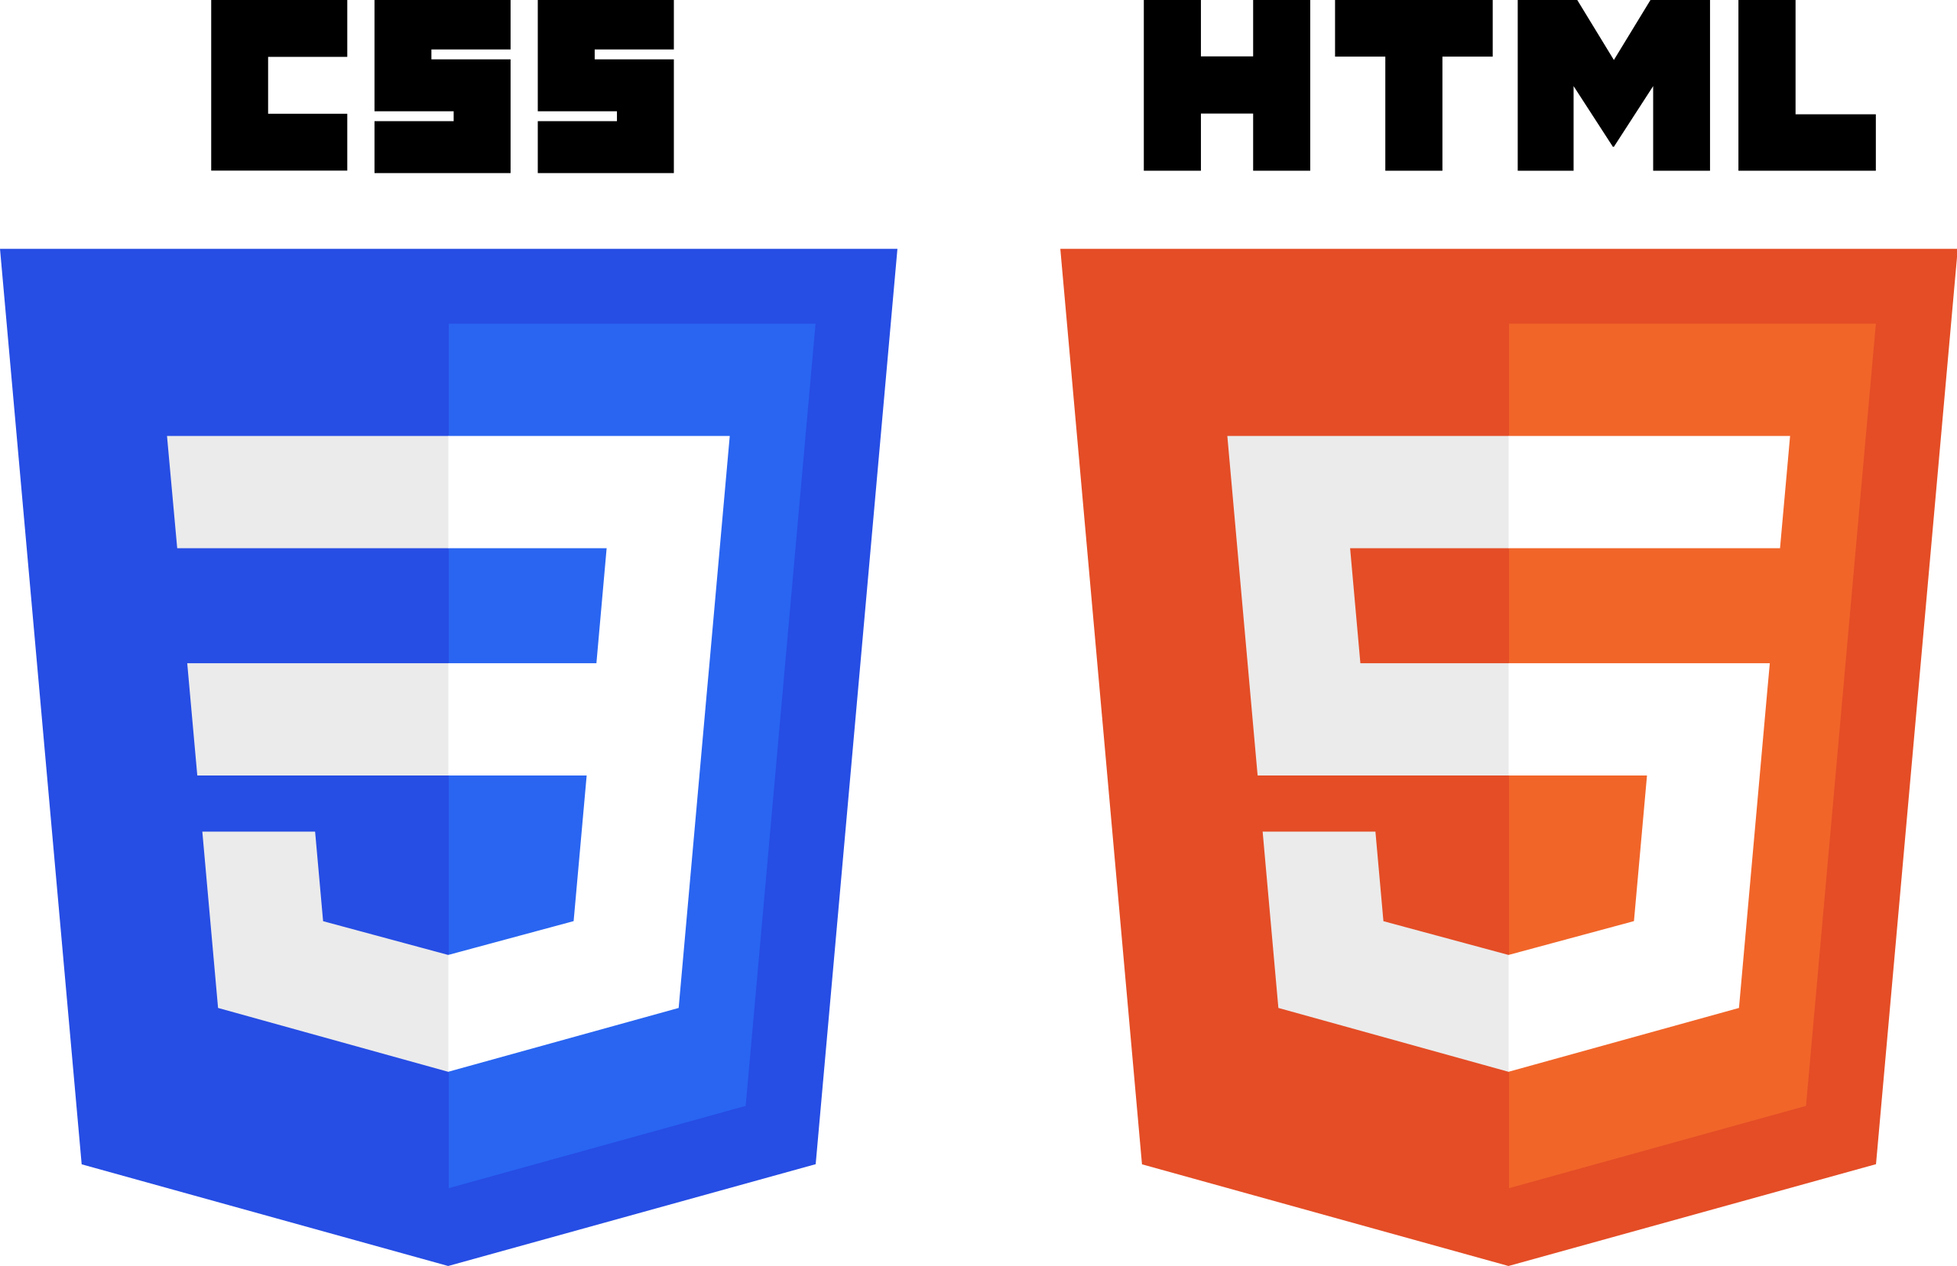

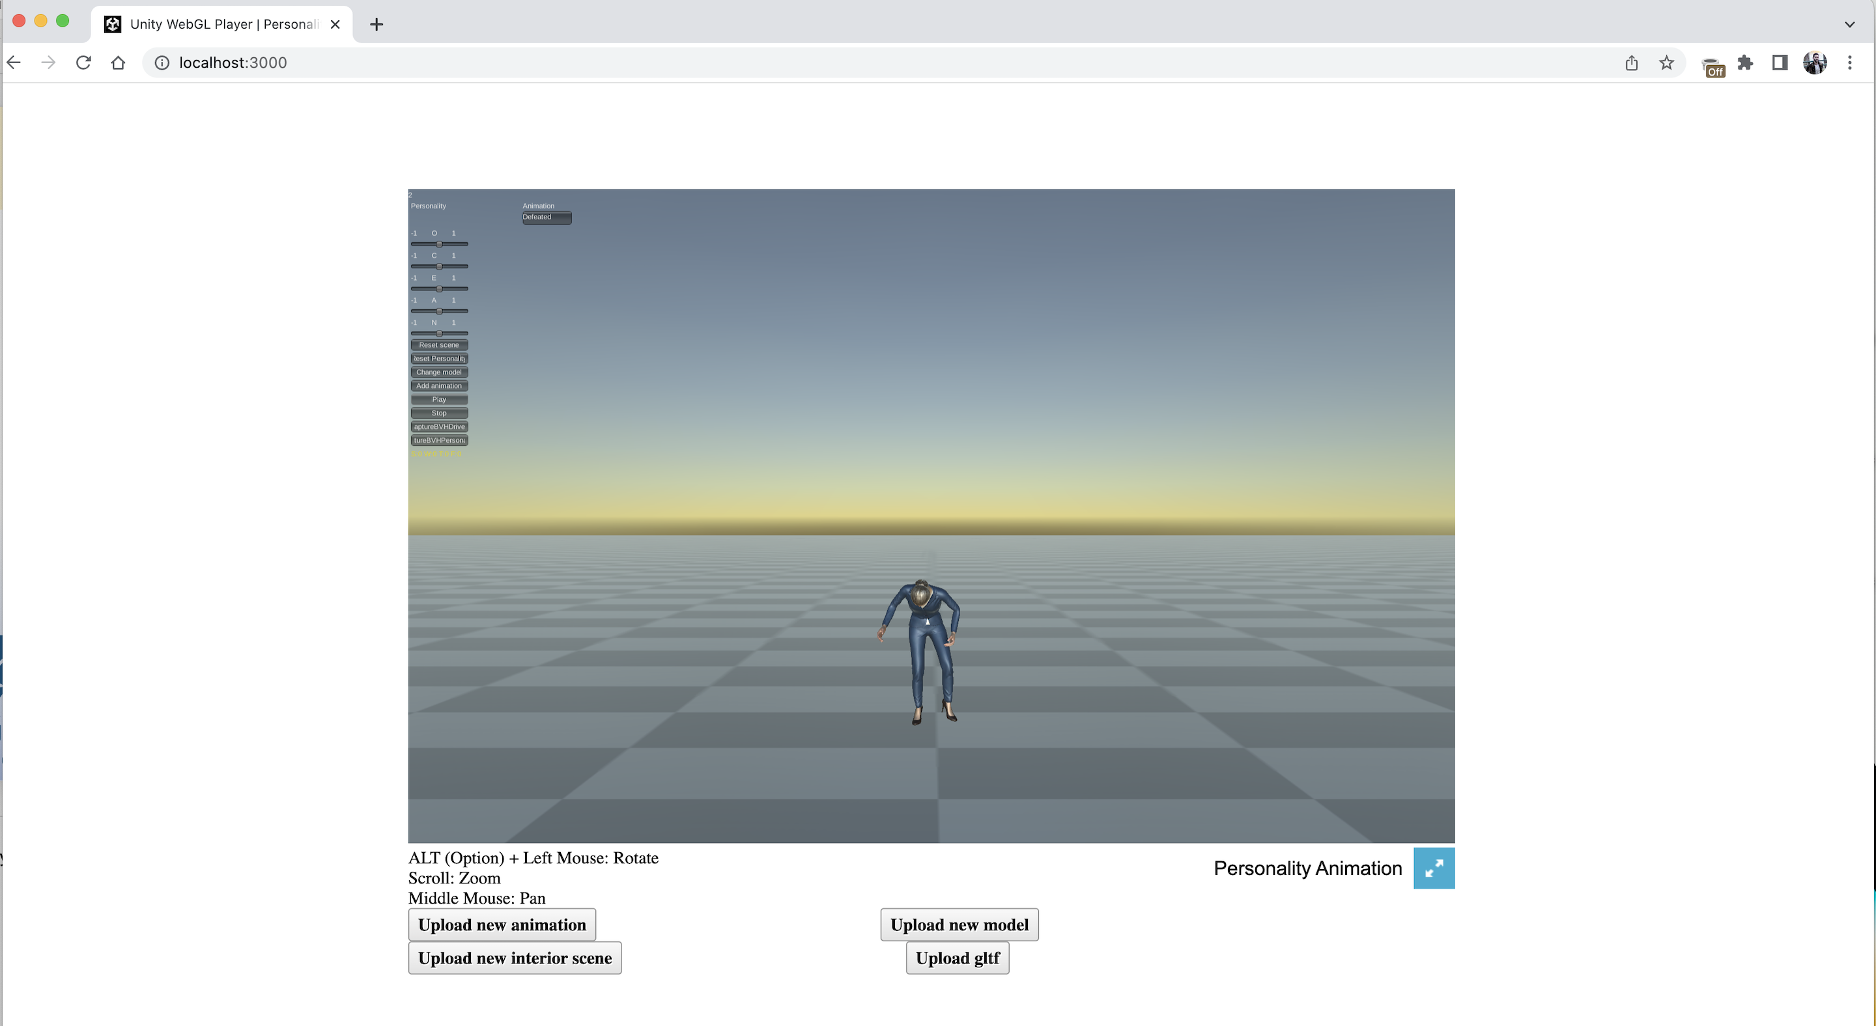



User Friendly Personality Animator: A Unity WebGL Application
Notes:
Focus: A user-friendly Unity WebGL application to the end of customizing virtual environments while imbuing humanoid models with personality.

Slide 2
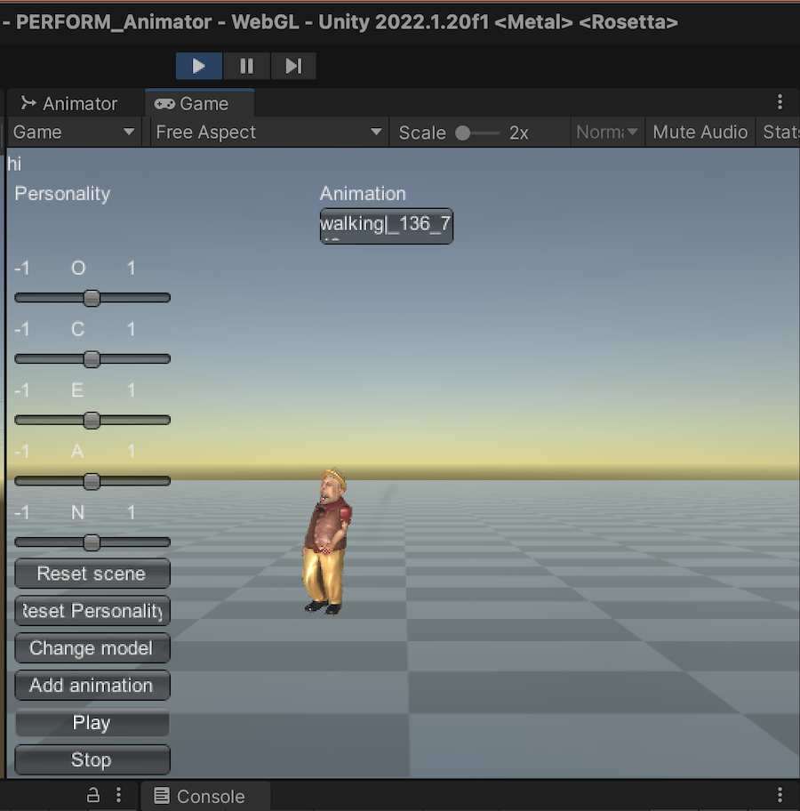
Goals and Motivation
Easy-to-use accessible application:
Users enjoy the experience of virtual environments
Users have freedom to upload chosen animations, humanoid models, and scene objects
Users can stylize their animations with personality
Users can save the motion data behind their stylization
Goals:
- Learn Unity IDE concepts to import and render models and animations
- Observe and work with these concepts via the Unity Engine API
- Apply these concepts to a Unity WebGL Build
- Host project remotely via a Google or Amazon VM
Notes:
Third goal very noteworthy; many problems encountered due to limitations for server side coding to client side, and Browser JS interfacing to Unity Engine API.

Slide 3
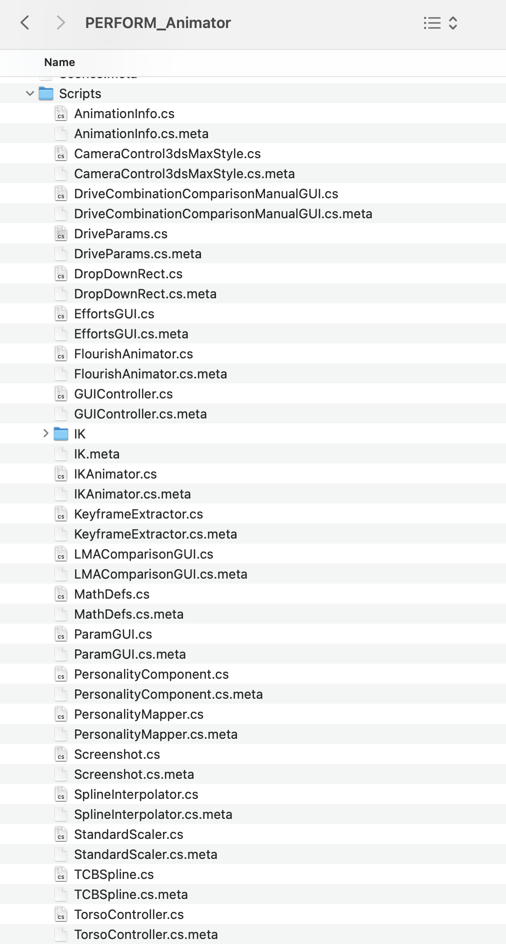
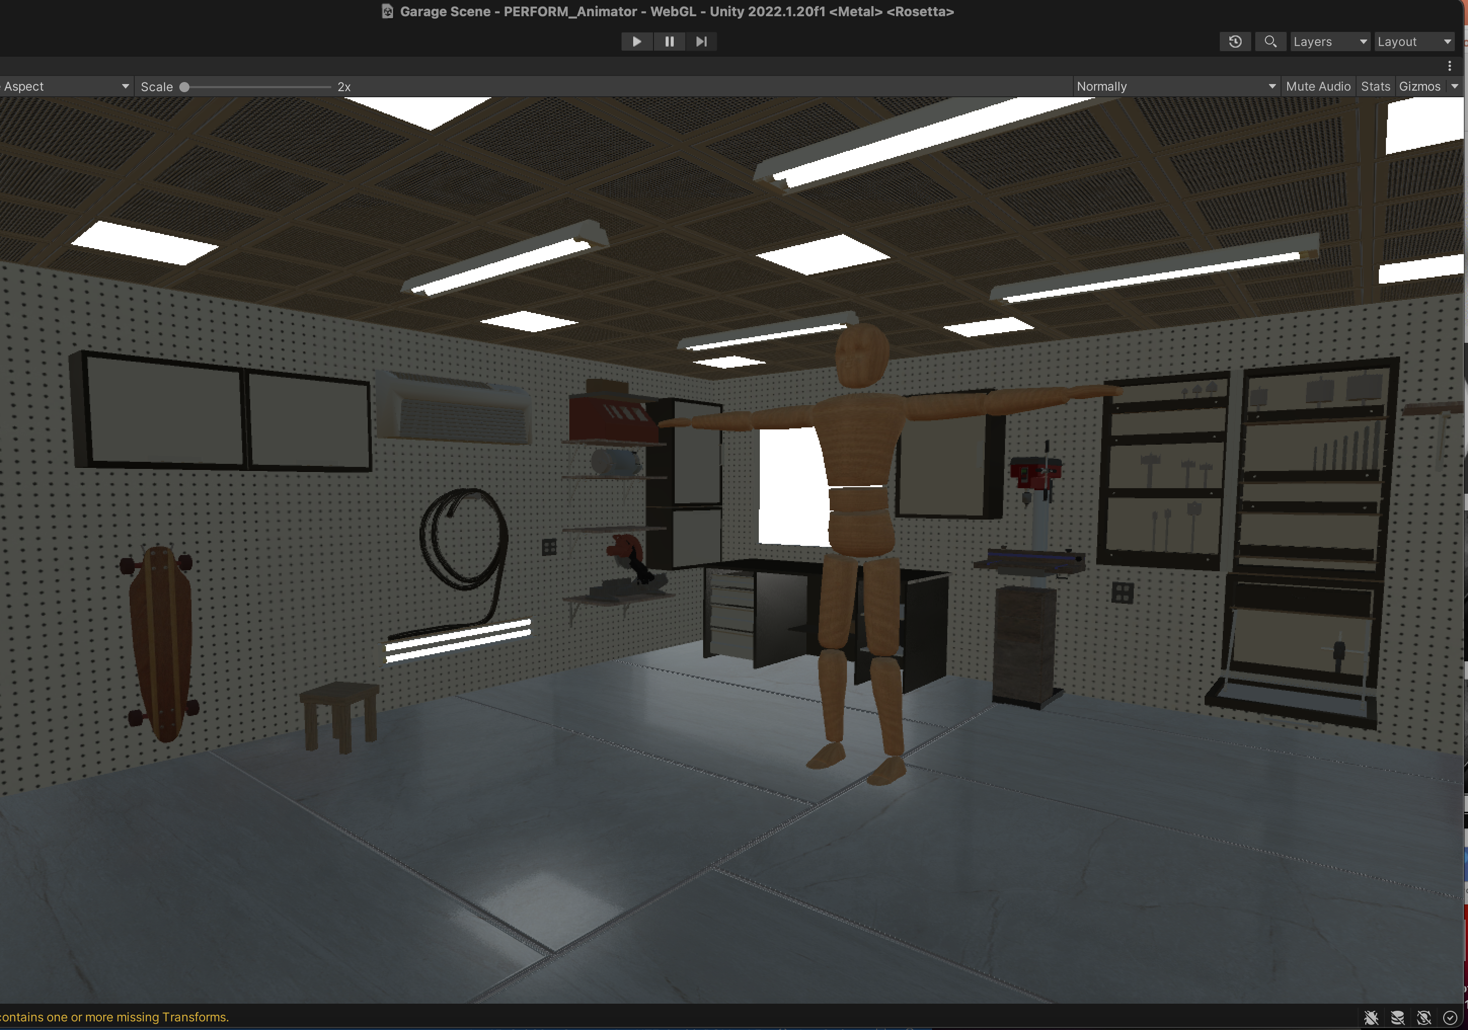
Challenges
Extensive project file system for all things Unity API related.
Unity plus Unity IDE concepts and their uses: e.g., Scene Hierarchy, Transforms, Assets, Prefabs, Components, Inspector, Avatar, Model, Game Object.
Importing any model into Unity, via the Browser, during runtime.
Unity WebGL build overwriting index.html and style.css.

Slide 4
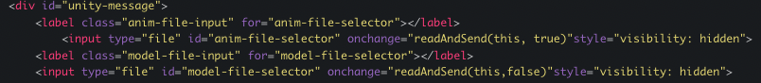
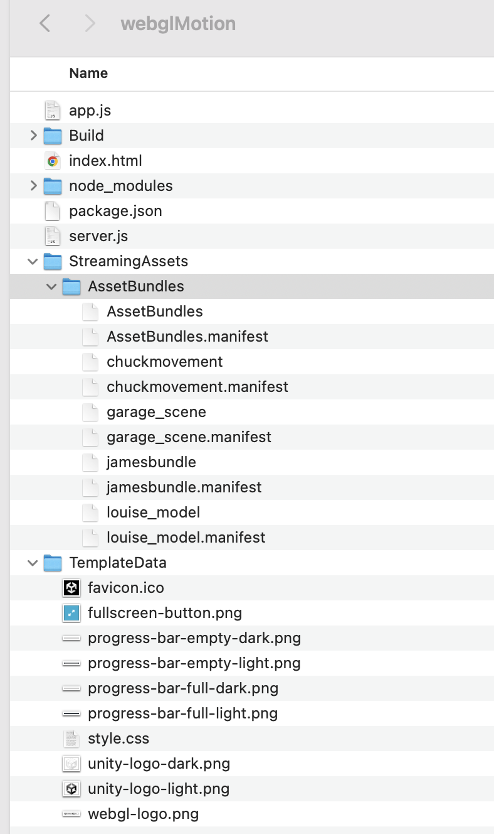
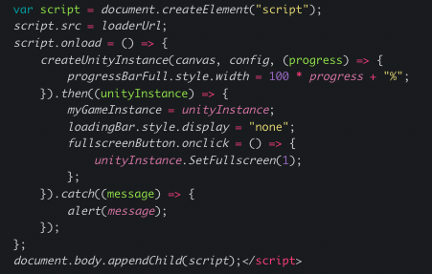
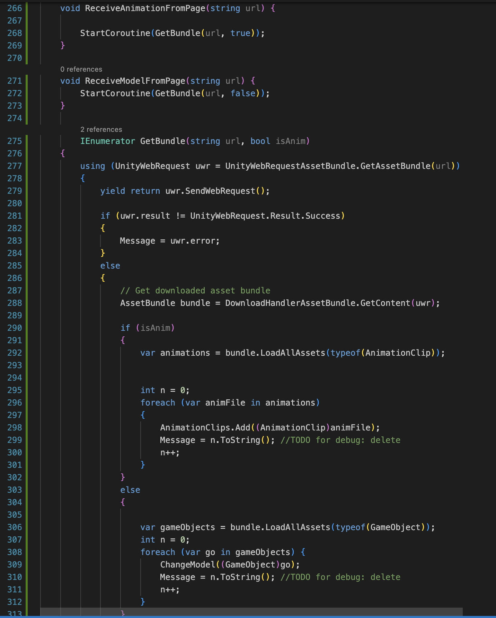
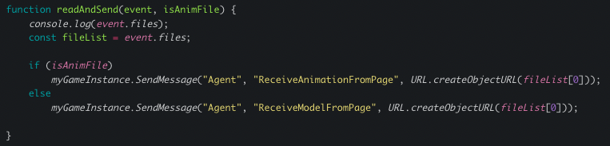
Browser JS to Unity Build Interfacing considerations
Solution 1:
Passing file contents to Unity API as a url, referencing Asset Bundles
Problem:
Asset Bundles must be built in Editor Mode prior to a project build
Notes:
The Unity WebGL build option interfaces JS programs, which use HTML5 technologies, with Unity in order to publish content, leveraging the WebGL rendering API to run Unity content in a web browser.

Slide 5
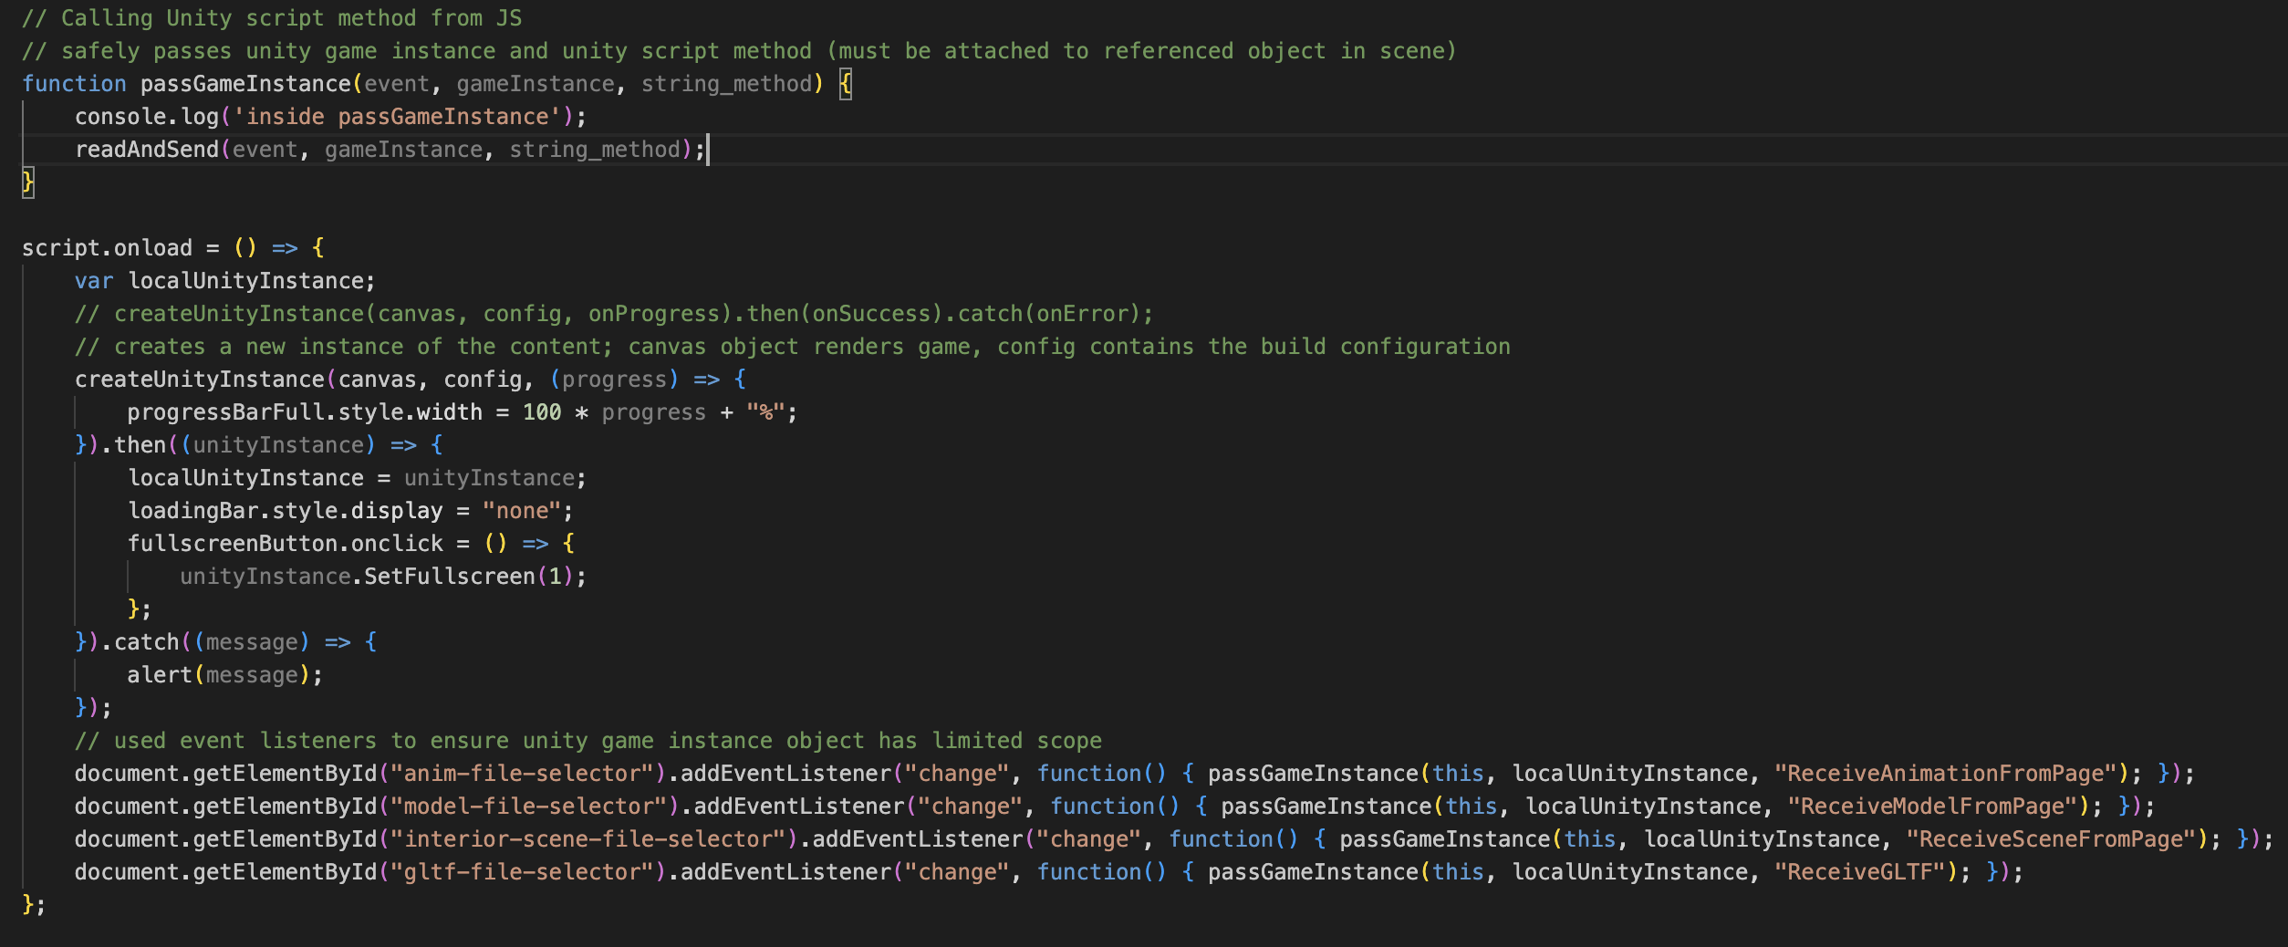
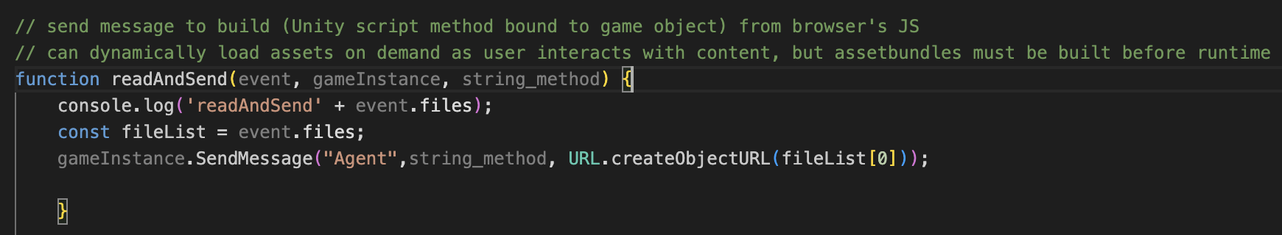
Browser JS to Unity Build Updates
Safely pass instance of project content by limiting its scope. Handle game object type through argument.
Solution 2:
Look into GLTF importer

Slide 6
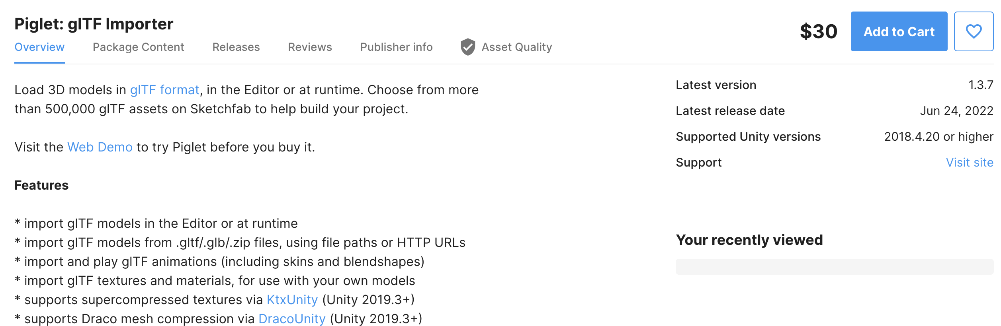
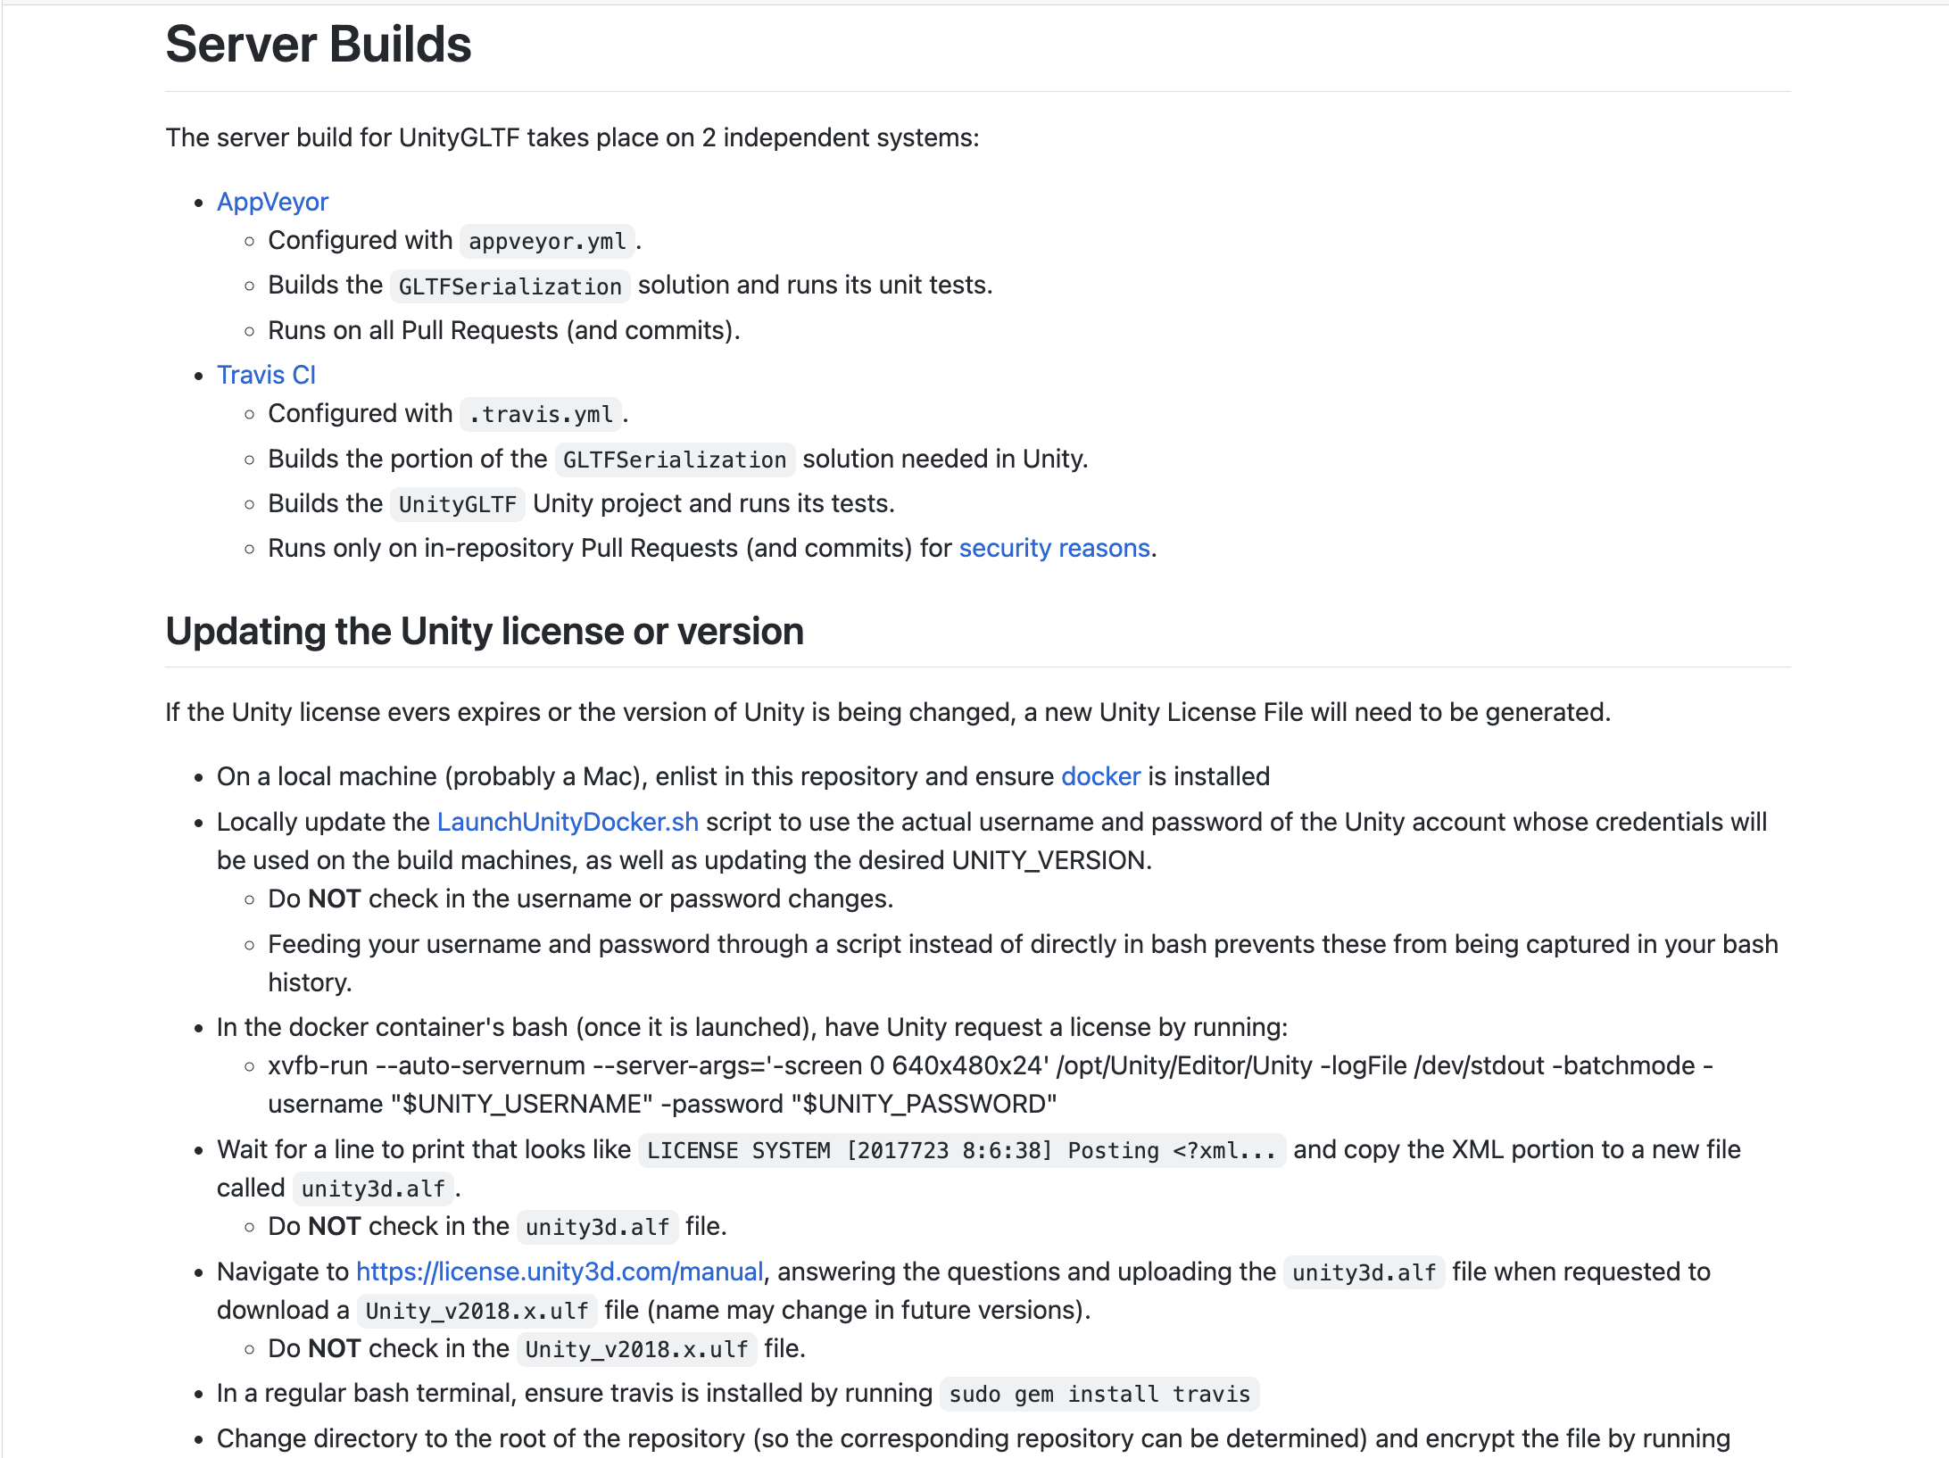
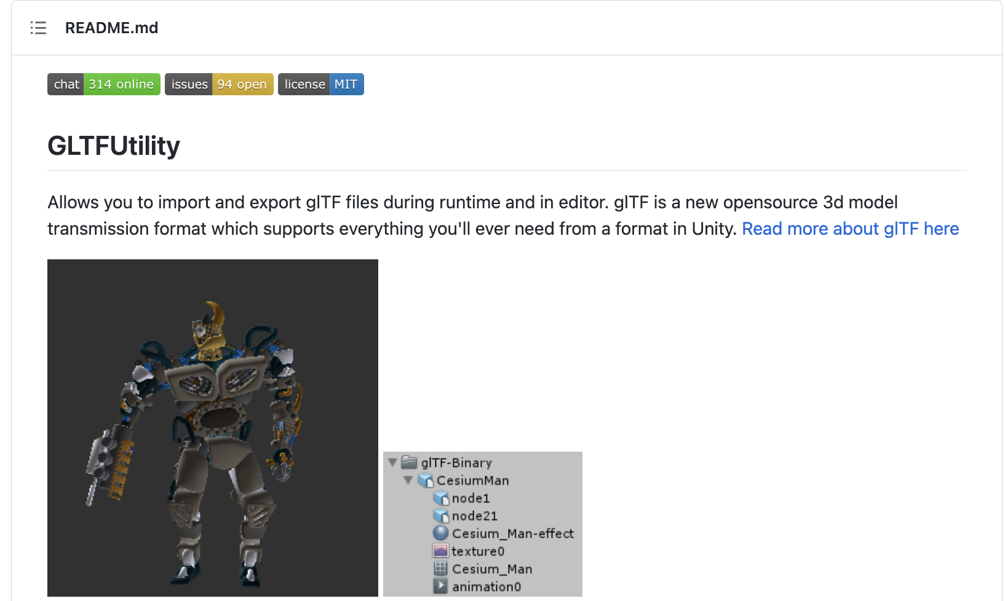
GLTF importers
KhronosGroup/UnityGLTF
Unity Asset Store – Piglet glTF Importer
Siccity/GLTFUtility
Notes:
Looking for options to import and export glTF files during runtime. Strange that someone implemented 2 projects in one, and you need to rebuild their libraries in other to make it work. Importing models from local files requires changes to the plugin code.
Paying for a proprietary tool is not the best option.
Settled for GLTFUtility

Slide 7
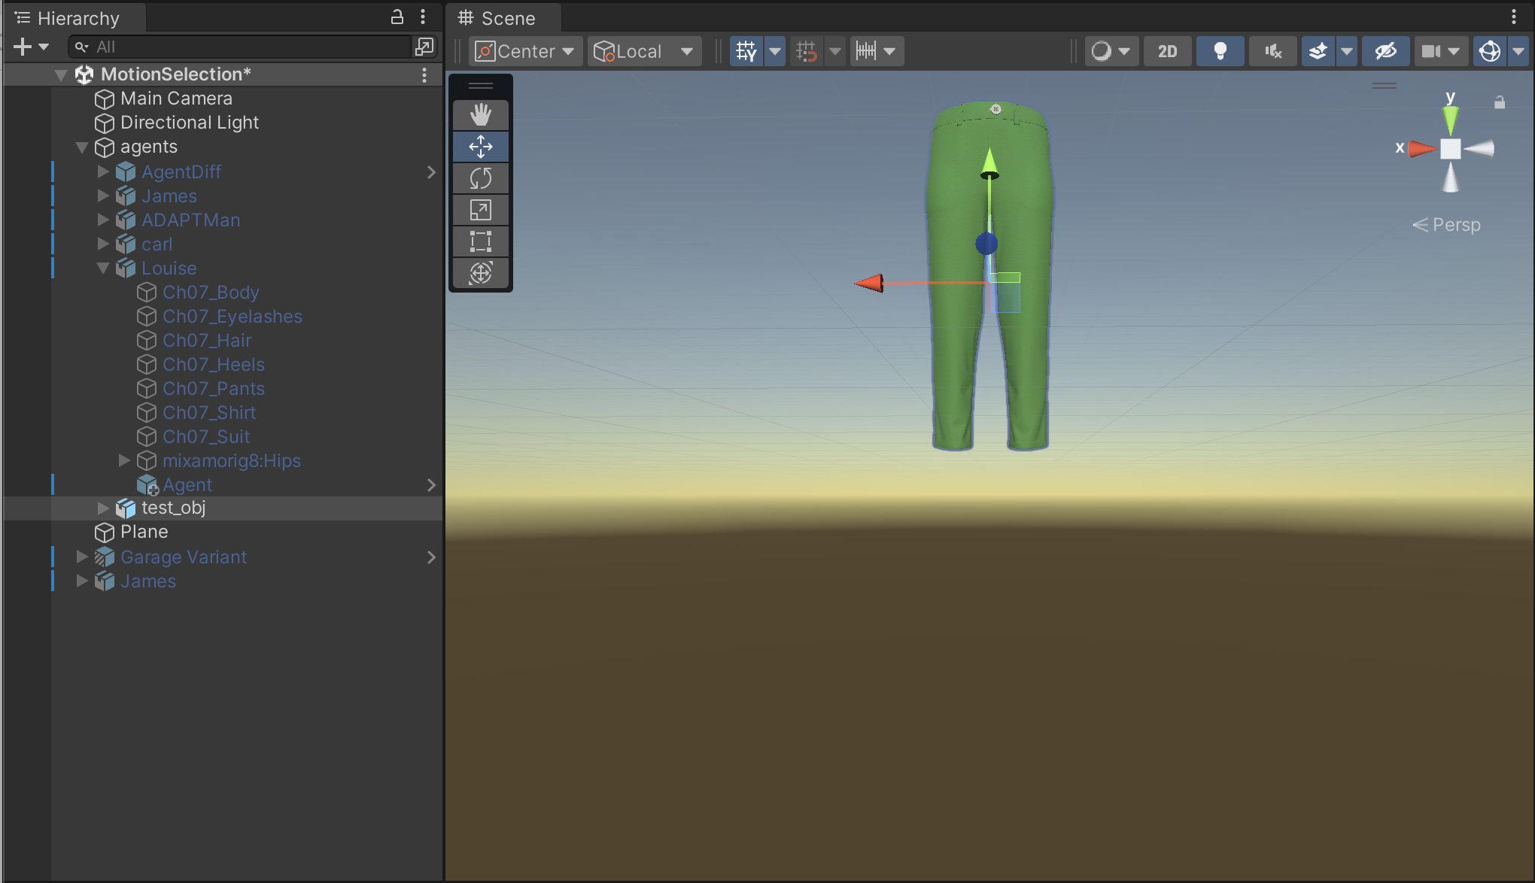
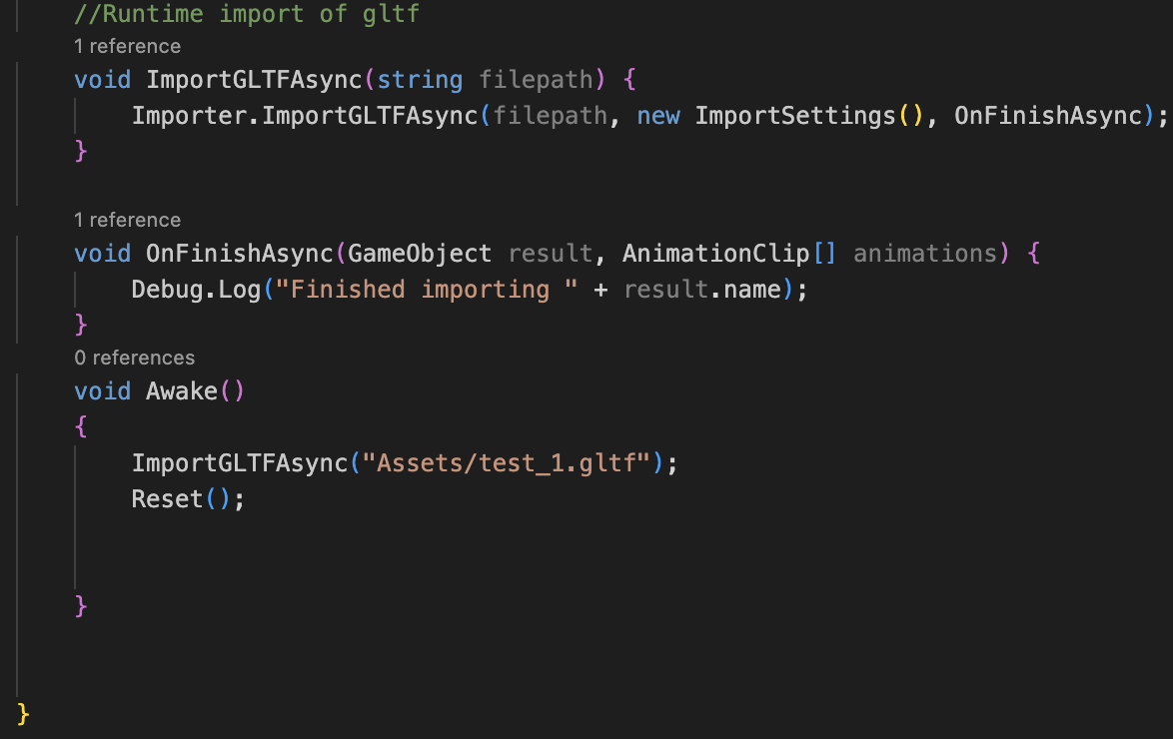
GLTF Utility – Developer GLTF Utility – WebGL Build
Building Library/Bee/artifacts/WebGL/build/debug_WebGL_wasm/build.js failed with output: error: undefined symbol: DecodeDracoMesh (referenced by top-level compiled C/C++ code) warning: Link with `-s LLD_REPORT_UNDEFINED` to get more information on undefined symbols warning: To disable errors for undefined symbols use `-s ERROR_ON_UNDEFINED_SYMBOLS=0` warning: _DecodeDracoMesh may need to be added to EXPORTED_FUNCTIONS if it arrives from a system library error: undefined symbol: GetAttribute (referenced by top-level compiled C/C++ code) warning: _GetAttribute may need to be added to EXPORTED_FUNCTIONS if it arrives from a system library error: undefined symbol: GetAttributeByType (referenced by top-level compiled C/C++ code) warning: _GetAttributeByType may need to be added to EXPORTED_FUNCTIONS if it arrives from a system library error: undefined symbol: GetAttributeByUniqueId (referenced by top-level compiled C/C++ code) warning: _GetAttributeByUniqueId may need to be added to EXPORTED_FUNCTIONS if it arrives from a system library error: undefined symbol: GetAttributeData (referenced by
Notes:
Turns out the plugin is great under developer mode but terrible for the WebGL Build option

Slide 8
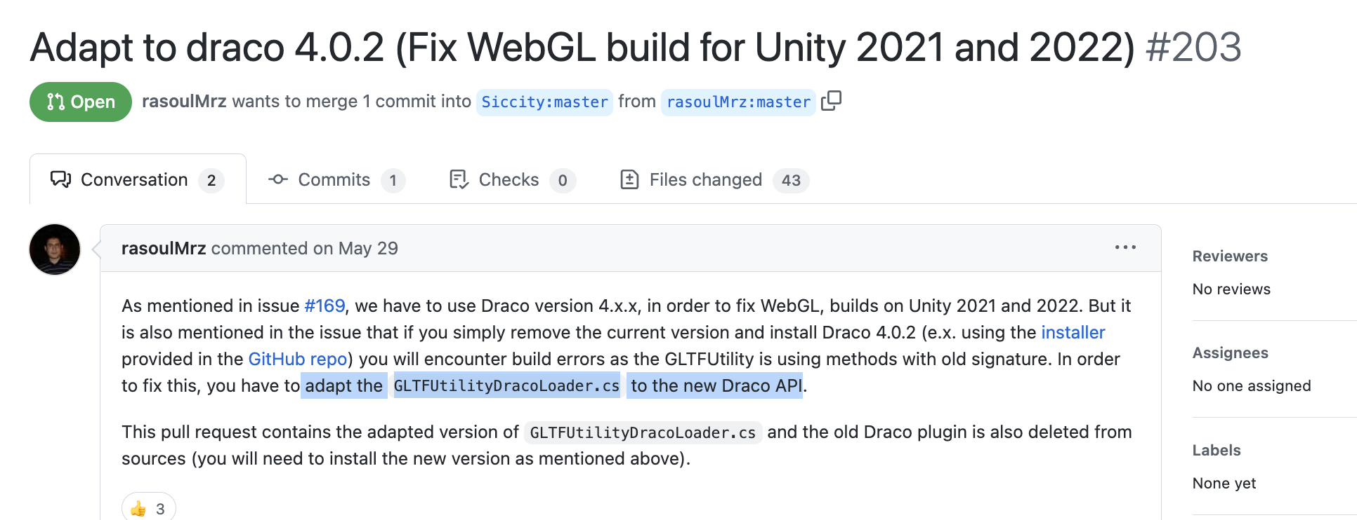
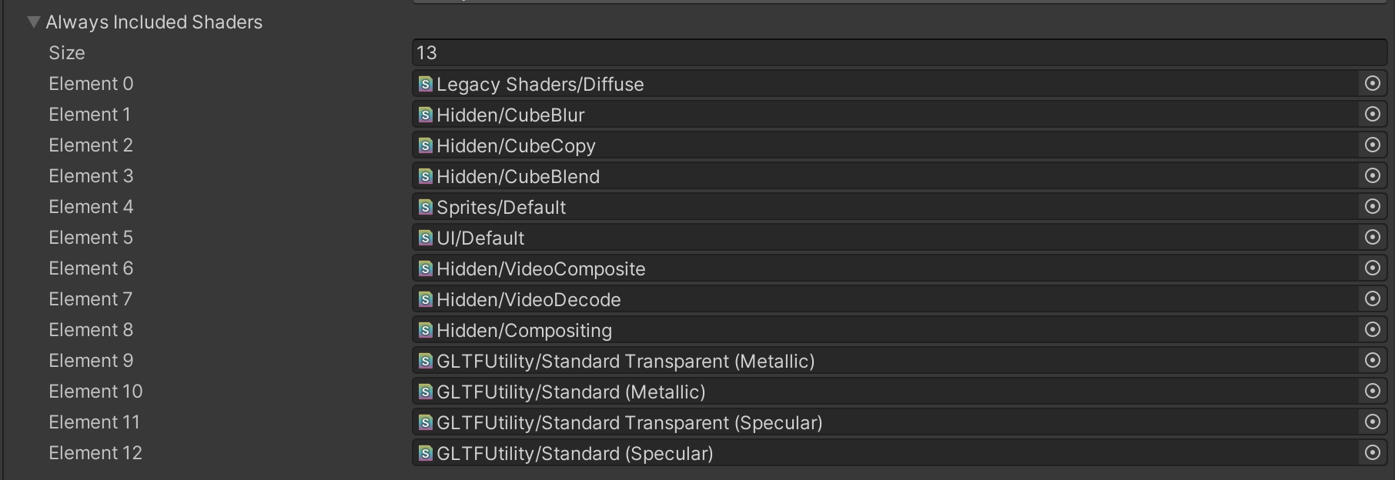
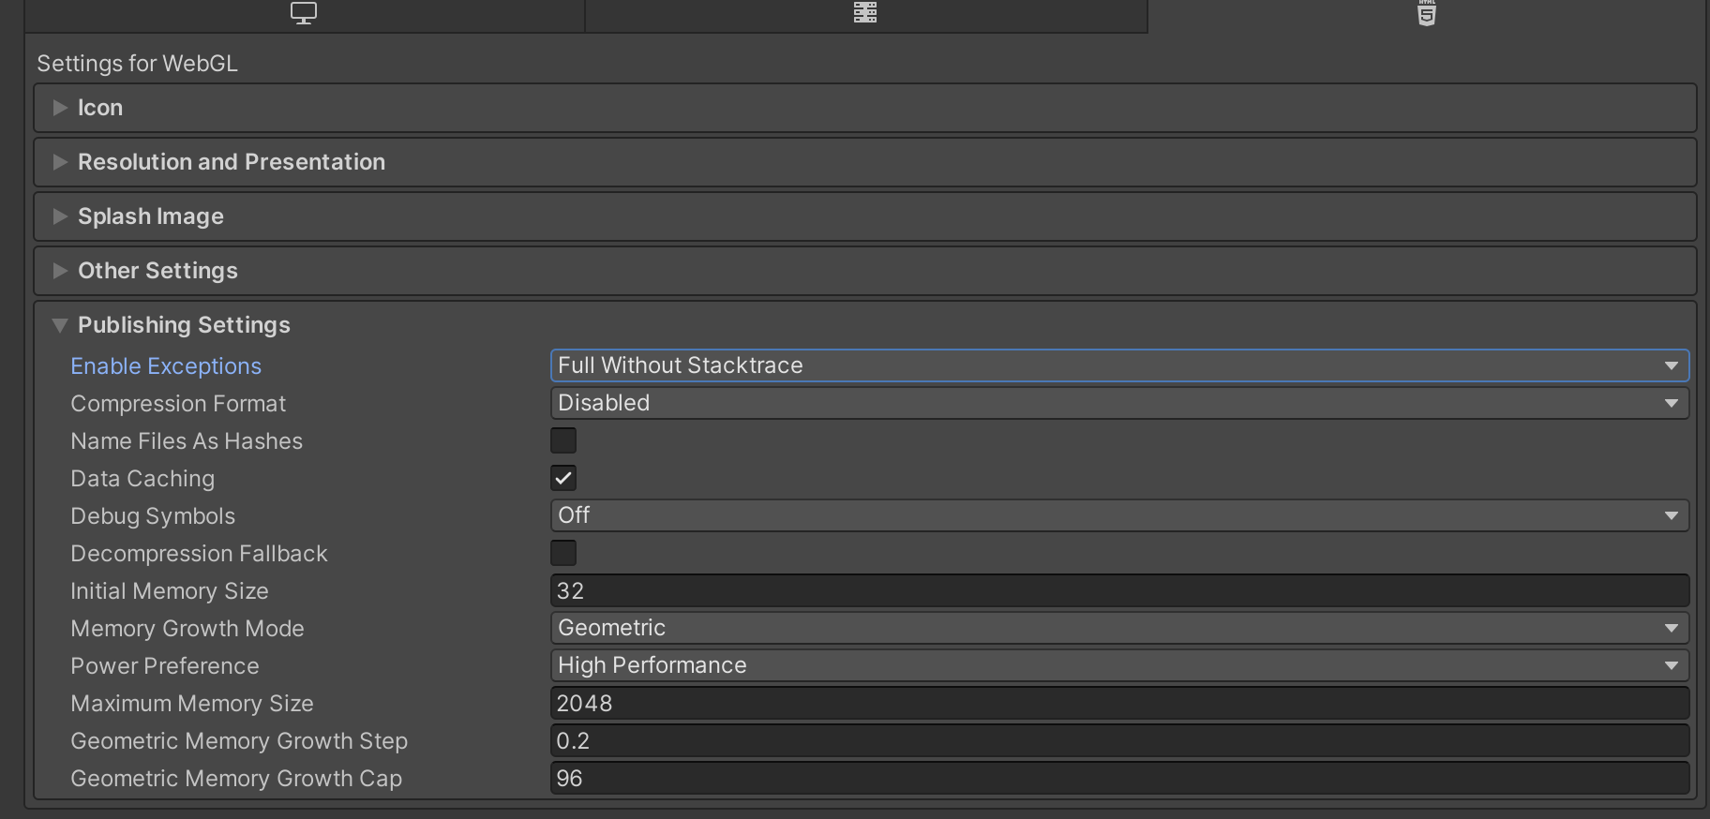
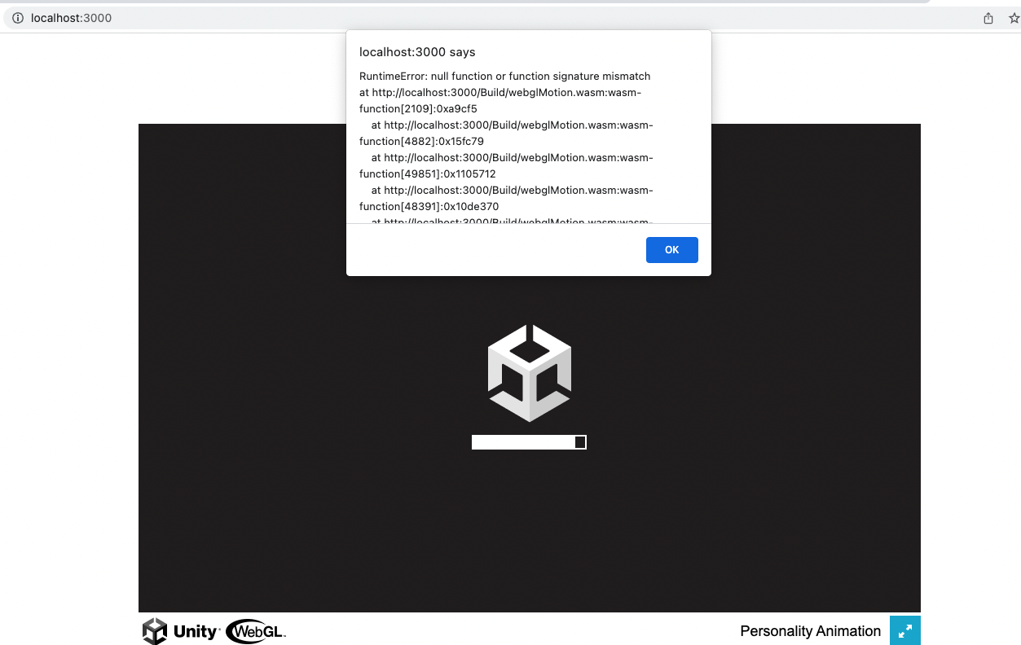
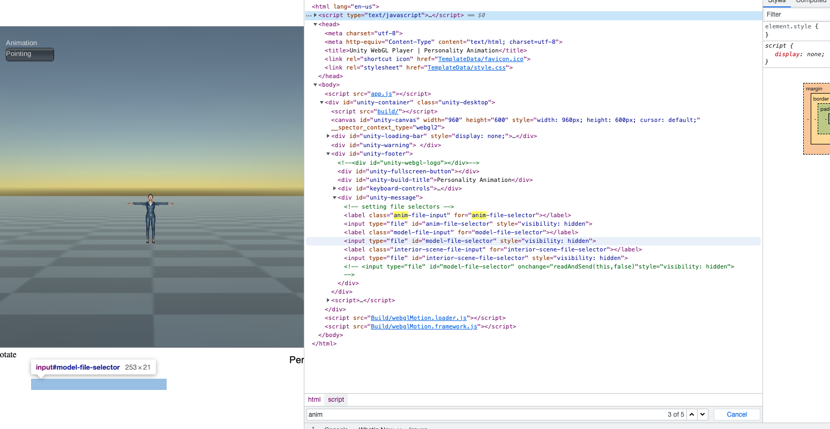
GLTF Utility – WebGL Build
Notes:
Needed to 0) Add shaders to ‘always included shaders’ of Unity’s Graphics Project Setting, 1) delete the Draco plugin folder, 2) install a new version of Draco, change GLTFUtilityDracoLoader.cs to adapt it to the new Draco version (replacing the whole Draco folder with that of rasoulMrz under plugins lead to an unsafe code error that could not be pypassed).

Slide 9
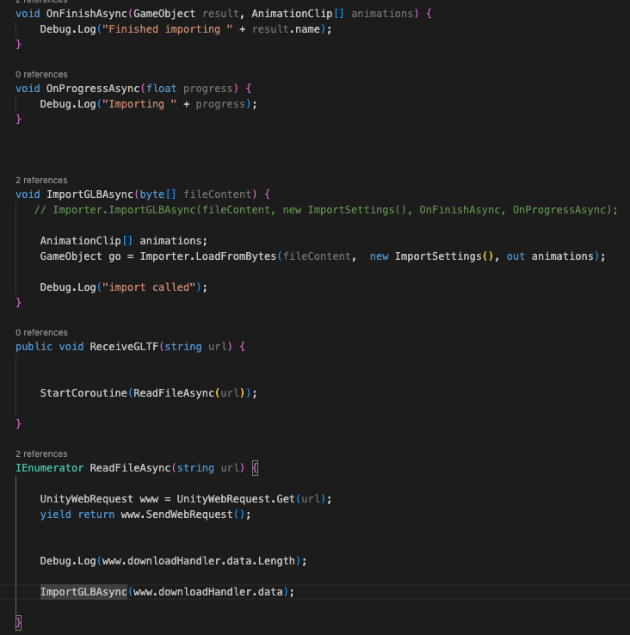
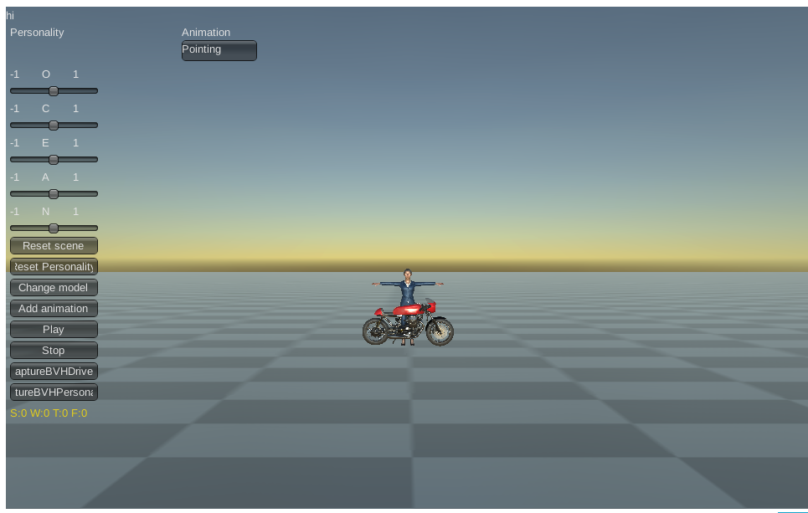
GLTF Utility – WebGL Build
Notes:
Needed to 0) Add shaders to ‘always included shaders’ of Unity’s Graphics Project Setting, 1) delete the Draco plugin folder, 2) install a new version of Draco, change GLTFUtilityDracoLoader.cs to adapt it to the new Draco version (replacing the whole Draco folder with that of rasoulMrz under plugins lead to an unsafe code error that could not be pypassed).

Slide 10
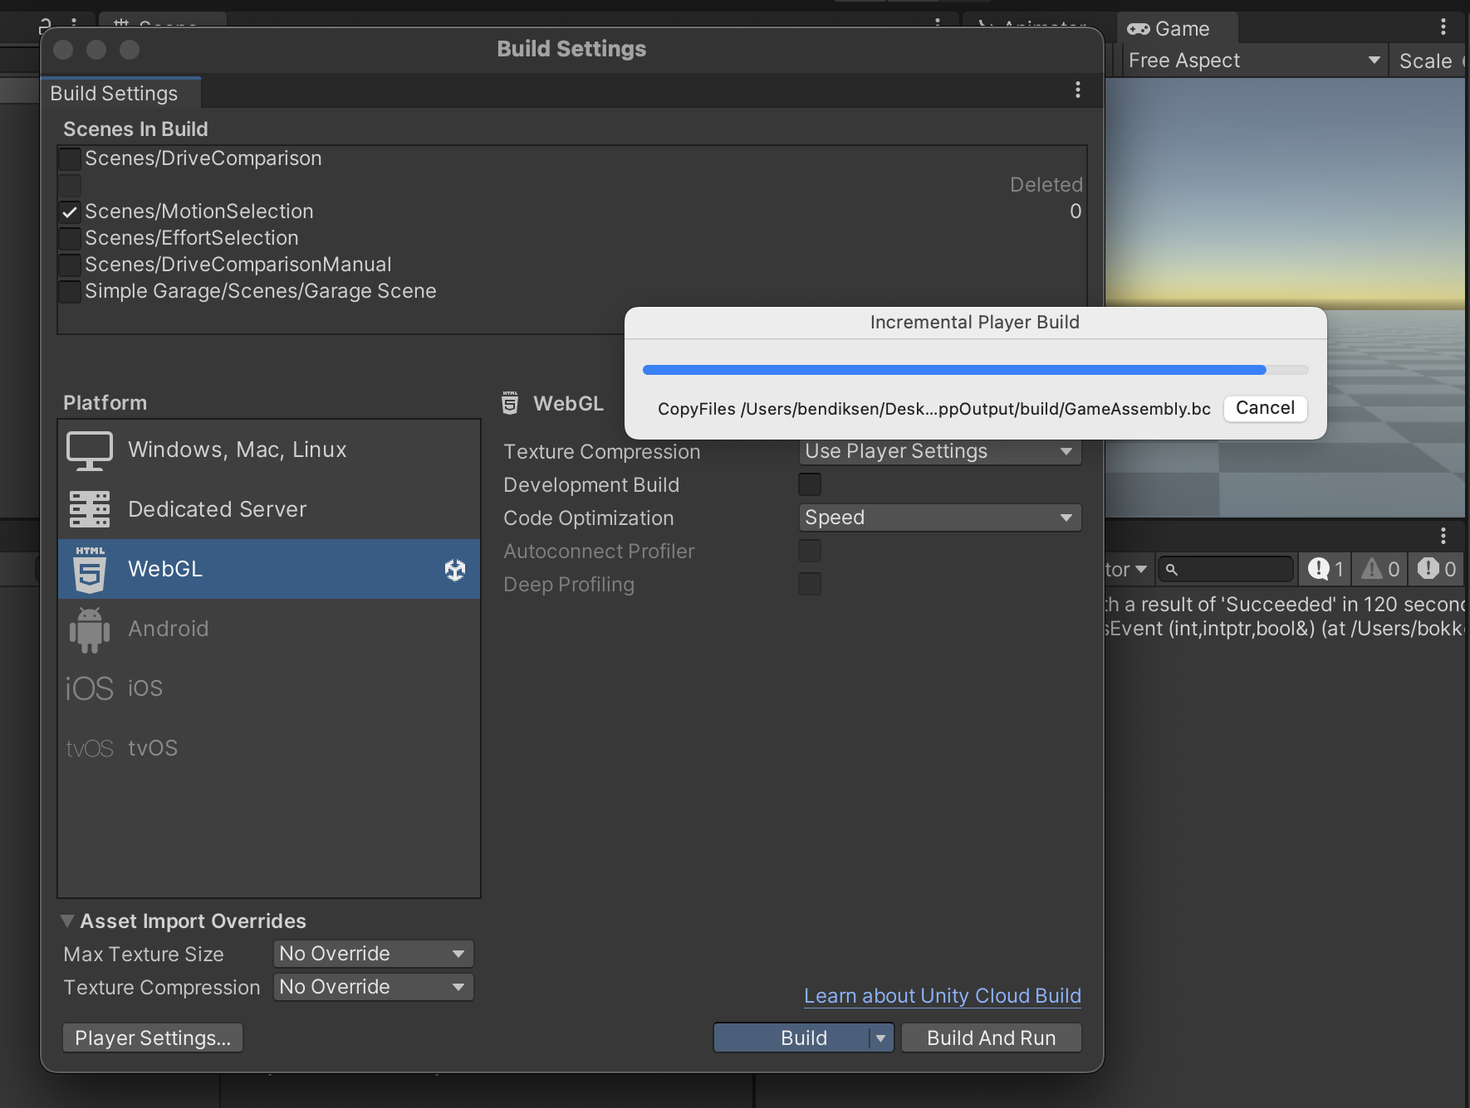
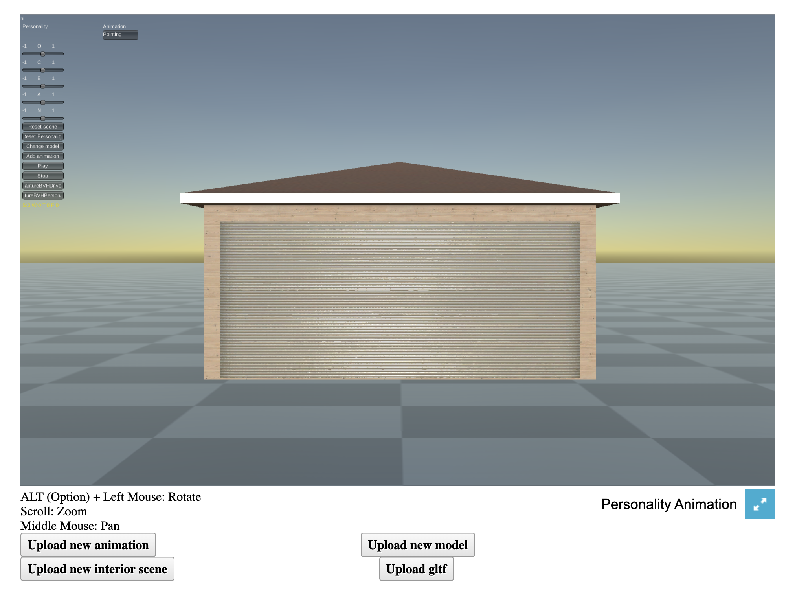
Current Limitations
Direct model import from online source challenging. Incorporating materials/textures to model, and model-avatar bone mapping not always automatic
Remote hosting still not implemented
Still need to allow users to save stylized motion data
Unable to rotate camera with trackpad
Build time notoriously slow

Slide 11
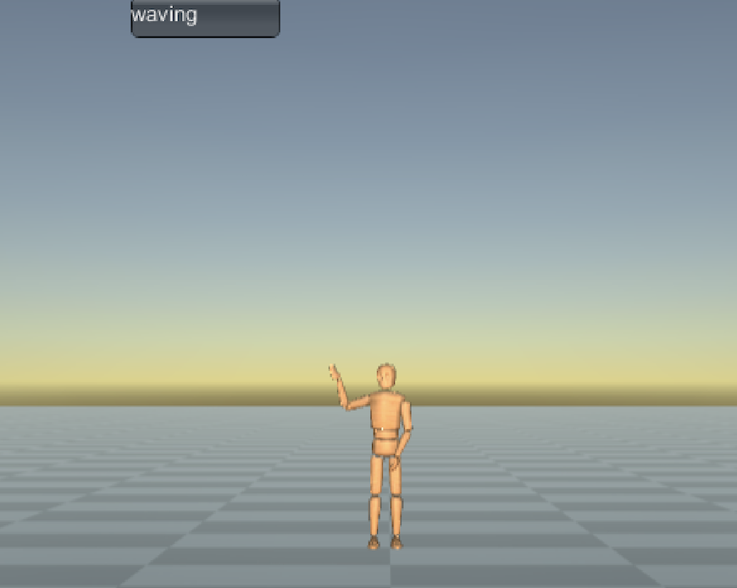


User Friendly Personality Animator: Thank You
Special Thanks to Professor Funda for being constantly available to help me reason through, diagnose and debug problems.
Durupinar, F., Kapadia, M., Deutsch, S., Neff, M., & Badler, N. I. (2017). PERFORM: Perceptual Approach for Adding OCEAN Personality to Human Motion Using Laban Movement Analysis. ACM Transactions on Graphics, 36(1), 1–16. https://doi.org/10.1145/2983620

